Slide 1
Angular JS

Slide 2
Why Angular?
Angular is a JavaScript framework from Google which was used for the development of web applications.
​​​​​​​Cross-Browser Compliant
Angular helps to create cross-browser compliant applications easily.
Typescript Support
Angular is written in Typescript and allows the user to build applications using Typescript. Typescript is a superset of JavaScript. The use of Typescript in application development improves productivity significantly.

Slide 3
Web Components Support
Angular is focused on component-based development. The use of components helps in creating loosely coupled units of application that can be developed, maintained, and tested easily.
Better support for Mobile App Development
Desktop and mobile applications have separate concerns and addressing these concerns using a single framework becomes a challenge. However, the Angular framework, addresses the concerns of both mobile as well as desktop applications using additional plugins.

Slide 4
Better performance
The Angular framework is better in its performance in terms of browser rendering, animation, and accessibility across all the components.

Slide 5
What is Angular?
Single Page Application (SPA)
For example, the Amazon web application. When you click on the various links present in the navbar present in any of the web pages of this application, the whole page gets refreshed. This is because visibly, a new request is sent for the new page for almost each user click. You may hence observe that it is not a SPA.
Angular helps to create SPAs that will dynamically load contents in a single HTML file, giving the user an illusion that the application is just a single page.

Slide 6
Example: Gmail web application, you will observe that all user interactions are being handled without completely refreshing the page.
Modern web applications are generally SPAs.
SPAs provide a good user experience by communicating asynchronously (a preferable way of communication) with a remote web server (generally using HTTP protocol) to dynamically check the user inputs or interactions and give constant feedback to the user in case of any errors, or wrongful/invalid user interaction.
They are built block-by-block making all the functionalities independent of each other. All desktop apps are SPAs in the sense that only the required area gets changed based on user requests.

Slide 7
Angular is an open-source JavaScript framework for building both mobile and desktop web applications.
Angular is exclusively used to build Single Page Applications (SPA).
Developers prefer TypeScript to write Angular code. But other than TypeScript, you can also write code using JavaScript (ES5 or ECMAScript 5).

Slide 8
Why most developers prefer TypeScript for Angular?
TypeScript is Microsoft’s extension for JavaScript which supports object-oriented features and has a strong typing system that enhances productivity.
TypeScript supports many features like annotations, decorators, generics, etc. A very good number of IDE’s like Sublime Text, Visual Studio Code, Nodeclipse, etc., are available with TypeScript support.
TypeScript code is compiled to JavaScript code using build tools like npm, bower, gulp, webpack, etc., to make the browser understand the code.

Slide 9
Features of Angular:
Easier to learn: It is a more streamlined framework where developers will be focusing on writing JavaScript classes.
Good IDE support: Angular is written in TypeScript which is a superset of JavaScript and supports all ECMAScript 6 features. Many IDEs like Eclipse, Microsoft Visual Studio, Sublime Text, etc., have good support for TypeScript.

Slide 10
Familiar: Developers who are already proficient in Angular 1 will find it easy to migrate to Angular.
Cross-Platform: Angular is a single platform that can be used to develop applications for multiple devices.

Slide 11
Learn and Fast: Angular application's production bundle size is reduced by 100s of kilobytes due to which it loads faster during execution.

Slide 12
Bundle Budgets: Angular will take advantage of the bundle budgets feature in CLI which will warn if the application size exceeds 2MB and will give errors if it exceeds 5MB. Developers can change this in angular.json.
Simplicity: Angular 1 had 70+ directives like ng-if, ng-model, etc., whereas Angular has a very less number of directives as you use [ ] and ( ) for bindings in HTML elements.

Slide 13
Component-based:
Angular follows component-based programming which is the future of web development. Each component created is isolated from every other part of our application. This kind of programming allows us to use components written using other frameworks.
Inside a component, you can write both business logic and view.
Every Angular application must have one top-level component referred to as 'Root Component' and several sub-components or child components.

Slide 14
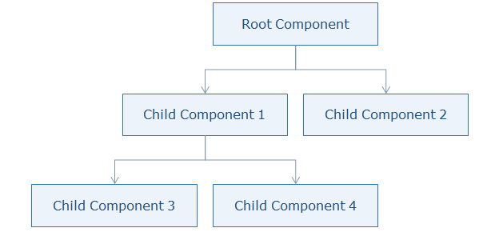

Slide 15
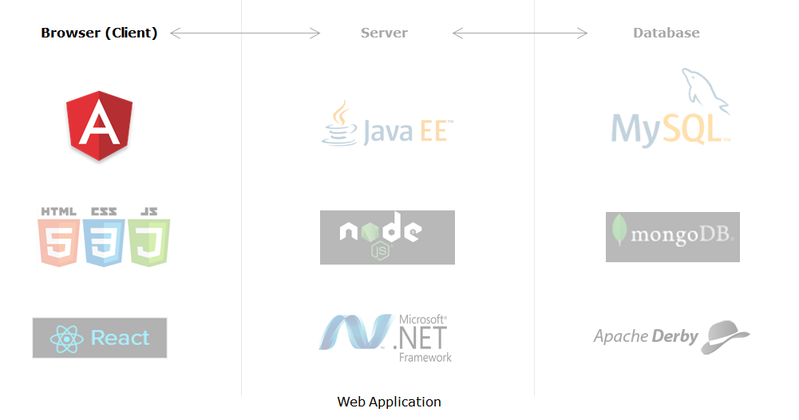
Angular in Web Application Stack

Slide 16
Angular places itself on the client-side in the complete application stack and provides a completely client-side solution for quick application development.
Angular has absolutely no dependencies and also works perfectly with any possible server-side technology like Java, NodeJS, PHP, etc., and any database like MongoDB, MySql.

Slide 17
Angular Application Setup
To develop an application using Angular on a local system, you need to set up a development environment that includes the installation of:
Node.js (^12.20.2 || ^14.15.5 || ^16.10.0) and npm (min version required 6.13.4)
Angular CLI
Visual Studio Code

Slide 18

Steps to install Node.js
Install Node.js
To check whether the Node is installed or not in your machine, go to the Node command prompt and check the Node version by typing the following command.
node -v
It will display the version of the node installed.

Slide 19
2. Steps to install Angular CLI
Angular CLI can be installed using node package manager as shown below:
Note: By default, Node Package Manager(NPM) points to global Node registry and downloads the Node modules from there.

Slide 20
Now run the following command to install CLI.
D:\> npm install -g @angular/cli
Test successful installation of Angular CLI using the following command

Slide 21
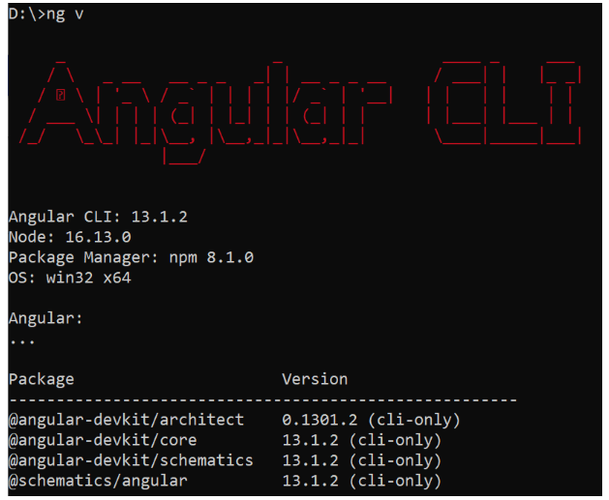

Slide 22
Angular CLI is a command-line interface tool to build Angular applications. It makes application development faster and easier to maintain.
Using CLI, you can create projects, add files to them, and perform development tasks such as testing, bundling, and deployment of applications.

Slide 23
Command | Purpose
npm install -g @angular/cli | Installs Angular CLI globally
ng new <project name> | Creates a new Angular application
ng serve --open | Builds and runs the application on lite-server and launches a browser
ng generate <name> | Creates a class, component, directive, interface, module, pipe, and service
ng build | Builds the application
ng update @angular/cli @angular/core | Updates Angular to latest version

Slide 24
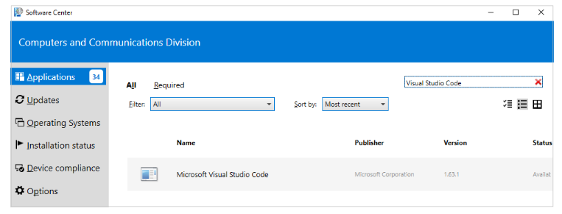
3. Steps to install Visual Studio Code
Install Visual Studio code from software house/software center as shown below or take help from CCD to get it installed:

Slide 25
Creating an Angular Application
Highlights:
Creating an Angular application using Angular CLI
Exploring the Angular folder structure
Demosteps:
1. Create an application with the name 'MyApp' using the following CLI command
D:\>ng new MyApp

Slide 26
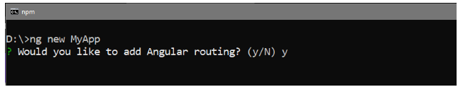
2. The above command will display two questions. The first question is as shown below. Typing 'y' will create a routing module file (app-routing.module.ts).
Next, you will learn about the app-routing.module.ts file.

Slide 27
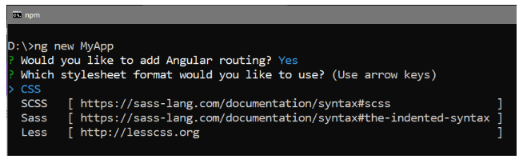
3. The next question is to select the stylesheet to use in the application. Select CSS and press Enter as shown below:

Slide 28
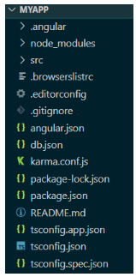
This will create the following folder structure with the dependencies installed inside the node_modules folder.

Slide 29
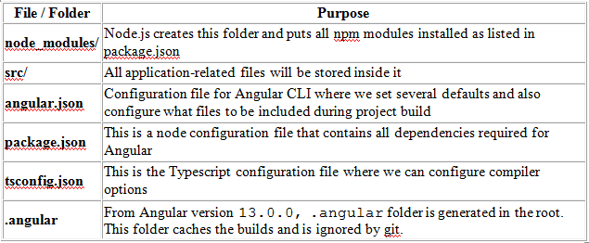
Note: If the above command gives errors while installing dependencies, navigate to the project folder in the Node command prompt and run "npm install" to install the dependencies manually.

Slide 30
Creating Components and Modules
A component is the basic building block of an Angular application.
It emphasize the separation of concerns and each part of the Angular application can be written independently of one another
It is reusable.

Slide 31
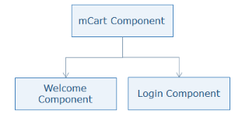
For example, mCart application the topmost component is the mCart component(AppComponent) which consists of child components called Welcome component, Login component, etc.

Slide 32
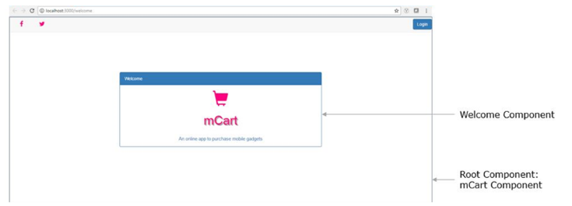

Slide 33
Creating a Component
Open Visual Studio Code IDE. Go to the File menu and select the "Open Folder" option. Select the MyApp folder you have created earlier.
Observe for our AppComponent you have below files
app.component.ts
app.component.html
app.component.css
Let us explore each one of them
Go to src folder-> app -> open app.component.ts file
Observe the following code

Slide 34
Observe the following code
import { Component } from '@angular/core';
@Component({
selector: 'app-root',
templateUrl: './app.component.html',
styleUrls: ['./app.component.css']
})
export class AppComponent {
title = 'AngDemo';
}

Slide 35
Line 2: Adds component decorator to the class which makes the class a component. Component decorator tells Angular if a particular class is a component or a module.
Line 3: Specifies the tag name to be used in the HTML page to load the component.
Line 4: Specifies the template or HTML file to be rendered when the component is loaded in the HTML page. The template represents the view to be displayed
Line 5: Specifies the stylesheet file which contains CSS styles to be applied to the template.

Slide 36
Line 7: Every component is a class (AppComponent, here) and export is used to make it accessible in other components
Line 8: Creates a property with the name title and initializes it to value 'AngDemo'
Open app.component.html from the app folder and observe the following code snippet in that file
<span>{{ title }} app is running!</span>
Line 3: Accessing the class property by placing property called title inside {{ }}. This is called interpolation which is one of the data binding mechanisms to access class properties inside the template.

Slide 37
Modules
Modules in Angular are used to organize the application.
A module in Angular is a class with the @NgModule decorator added to it. @NgModule metadata will contain the declarations of components, pipes, directives, services that are to be used across the application.
Every Angular application should have one root module which is loaded first to launch the application.
Submodules should be configured in the root module.

Slide 38
Root Module
In the app.module.ts file placed under the app folder, you have the following code:
import { BrowserModule } from '@angular/platform-browser';
import { NgModule } from '@angular/core';
import { AppRoutingModule } from './app-routing.module';
import { AppComponent } from './app.component';
@NgModule({
declarations: [ AppComponent ],
imports: [ BrowserModule, AppRoutingModule ],
providers: [],
bootstrap: [AppComponent] })
export class AppModule { }

Slide 39
Line 1: imports BrowserModule class which is needed to run the application inside the browser
Line 2: imports NgModule class to define metadata of the module
Line 5: imports AppComponent class from app.component.ts file. No need to mention the .ts extension as Angular by default considers the file as a .ts file
Line 8: declarations property should contain all user-defined components, directives, pipes classes to be used across the application. We have added our AppComponent class here

Slide 40
Line 11: imports property should contain all module classes to be used across the application
Line 15: providers' property should contain all service classes.
Line 16: bootstrap declaration should contain the root component to load.
In this example, AppComponent is the root component that will be loaded in the HTML page

Slide 41
Executing Angular Application
Execute the application and check the output.
Open terminal in Visual Studio Code IDE by selecting View Menu -> Integrated Terminal.
Type the following command to run the application
D:\MyApp>ng serve --open
ng serve will build and run the application
--open option will show the output by opening a browser automatically with the default port.

Slide 42
Note: If you get an error in the terminal like 'ng is not recognized', use the Node.js command prompt to run this command.
Use the following command to change the port number if another application is running on the default port(4200)
D:\MyApp>ng serve --open --port 3000

Slide 43
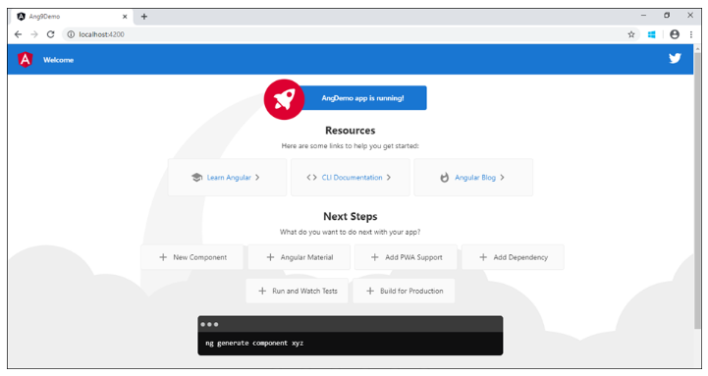

Slide 44
Introduction to Templates
Templates in Angular represents a view and its role is to display data and change the data whenever an event occurs
The default language for templates is HTML

Slide 45
Creating a template
Template can be defined in two ways:
Inline Template
External Template
Inline Template
You can create an inline template in a component class itself using the template property of the @Component decorator.

Slide 46
app.component.ts
import { Component } from '@angular/core';
@Component({
selector: 'app-root',
template: `
<h1> Welcome </h1>
<h2> Course Name: {{ courseName }}</h2>
`,
styleUrls: ['./app.component.css']
})
export class AppComponent {
courseName = "Angular";
}

Slide 47

Line 5-8: You can even write HTML code inside the component using the template property. Use backtick character (`) for multi-line strings.
Output:

Slide 48
External Template
By default, Angular CLI uses the external template.
It binds the external template with a component using templateUrl option.
Example
app.component.html
<h1> Welcome </h1>
<h2> Course Name: {{ courseName }}</h2>

Slide 49
app.component.ts
import { Component } from '@angular/core';
@Component({
selector: 'app-root',
templateUrl:'./app.component.html',
styleUrls: ['./app.component.css']
})
export class AppComponent {
courseName = "Angular";
}

Slide 50
Line 5: templateUrl property is used to bind an external template file with the component
Output:
Best Practices - Coding Style Rules
Always create a separate template file when the template code is more than 3 lines.
The path mentioned in the templateUrl property should be always relative.

Slide 51
Elements of Template
The basic elements of template syntax:
HTML
Interpolation
Template Expressions
Template Statements
HTML
Angular uses HTML as a template language. In the below example, the template contains pure HTML code.

Slide 52
Interpolation
Interpolation is one of the forms of data binding where component’s data can be accessed in a template. For interpolation, double curly braces {{ }} is used.

Slide 53
Template Expressions
The text inside {{ }} is called as template expression.
{{ expression }}
Angular first evaluates the expression and returns the result as a string. The scope of a template expression is a component instance.
That means, if you write {{ courseName }}, courseName should be the property of the component to which this template is bound.

Slide 54
Template Statement
Template Statements are the statements that respond to a user event.
(event) = statement
For example (click) = "changeName()"
This is called event binding. In Angular, all events should be placed in ( ).

Slide 55
Example:
app.component.ts
...
export class AppComponent {
courseName = "Angular";
changeName() {
this.courseName = "TypeScript";
}
}
Line 4-6: changeName is a method of AppComponent class where you are changing courseName property value to "TypeScript"

Slide 56
app.component.html
<h1> Welcome </h1>
<h2> Course Name: {{ courseName }}</h2>
<p (click)="changeName()">Click here to change</p>
Line 3: changeName() method is bound to click event which will be invoked on click of a paragraph at run time. This is called event binding.

Slide 57
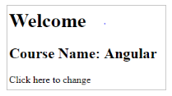
Output:
When a user clicks on the paragraph, the course name will be changed to 'Typescript'.

Slide 58
Change Detection
How does Angular detect the changes and update the application at the respective places?
Angular uses its change detection mechanism to detect the changes and update the application at the respective places.
Angular applications run faster than Angular 1.x applications due to the improved change detection mechanism.

Slide 59
What is the change detection mechanism, and how it helps to run Angular applications so fast?
Change Detection is a process in Angular that keeps views in sync with the models.
In Angular, the flow is unidirectional from top to bottom in a component tree. A change in a web application can be caused by events, Ajax calls, and timers which are all asynchronous.

Slide 60
Who informs Angular about the changes?
Zones inform Angular about the changes in the application. It automatically detects all asynchronous actions at run time in the application.

Slide 61
What does Angular do when a change is detected?
Angular runs a change detector algorithm on each component from top to bottom in the component tree. This change detector algorithm is automatically generated at run time which will check and update the changes at appropriate places in the component tree.

Slide 62
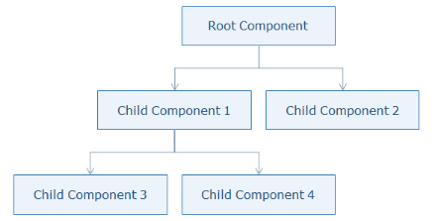

Slide 63
Structural Directives
Directives are used to change the behavior of components or elements. It can be used in the form of HTML attributes.
You can create directives using classes attached with @Directive decorator which adds metadata to the class.

Slide 64
Why Directives?
It modify the DOM elements
It creates reusable and independent code
It is used to create custom elements to implement the required functionality
Types of Directives
There are three types of directives available in Angular

Slide 65
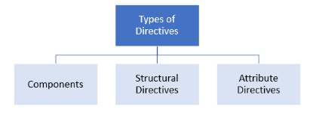

Slide 66
Components
Components are directives with a template or view.
@Component decorator is actually @Directive with templates
Structural Directives
A Structural directive changes the DOM layout by adding and removing DOM elements.
*directive-name = expression
Angular has few built-in structural directives such as:
ngIf
ngFor
ngSwitch

Slide 67
ngIf
ngIf directive renders components or elements conditionally based on whether or not an expression is true or false.
Syntax:
*ngIf = "expression"
ngIf directive removes the element from the DOM tree.

Slide 68
Example:
app.component.ts
...
export class AppComponent {
isAuthenticated!: boolean;
submitted = false;
userName!: string;
onSubmit(name: string, password: string) {
this.submitted = true;
this.userName = name;
if (name === "admin" && password === "admin") {
this.isAuthenticated = true;
} else {
this.isAuthenticated = false;
}
}
}

Slide 69
Line 5: Notice the use of ! with the property username. This is called adding definite assertion for variables during declaration.
Definite assertion for variables
Angular CLI creates all new workspaces and projects with strict mode enabled. This leads to an improved compile time check for properties. If any property is not initialized either by providing a default value or by initializing within the constructor or if a parameter is not mapped to a property, the below error gets generated:
property <<property>> has no initializer and is not definitely assigned in the constructor.

Slide 70
The correct fix to this is to assign the property with a value in the constructor.
An alternate is to permit the property with no definite assignment by using the definite assignment assertion. You can do that by adding ! to the property name.
userName in Line 5 of the above code doesn't have a value initialized and hence the use of !.
Line 7 -14: onSubmit method is invoked when the user clicks on the submit button in the template. This method checks the username and password values entered are correct or not and accordingly assigns a boolean value to isAuthenticated variable.

Slide 71
app.component.html
<div *ngIf="!submitted">
...
<button (click)="onSubmit(username.value, password.value)">Login</button>
</div>
<div *ngIf="submitted">
<div *ngIf="isAuthenticated; else failureMsg">
<h4>Welcome {{ userName }}</h4>
</div>
<ng-template #failureMsg>
<h4>Invalid Login !!! Please try again...</h4>
</ng-template>
<button type="button" (click)="submitted = false">Back</button>
</div>

Slide 72
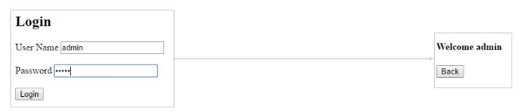
Line 7: Username will be displayed if 'isAuthenticated' property value is true otherwise it will be an error message.
Output:
After entering the correct credentials and clicking on the Login button.

Slide 73
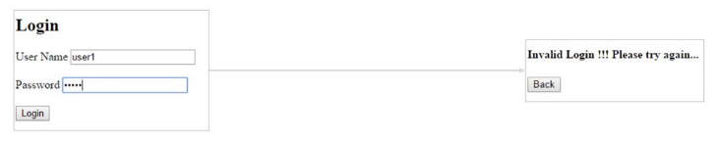
After entering incorrect credentials and clicking on the Login button.

Slide 74
ngFor
ngFor directive is used to iterate over-collection of data i.e., arrays
Syntax:
*ngFor = "expression"
Example:
app.component.ts
...
export class AppComponent {
courses: any[] = [
{ id: 0, name: "TypeScript" },
{ id: 1, name: "Angular" },
{ id: 2, name: "Node JS" },
{ id: 3, name: "TypeScript" }
];
}
Line 3-8: Creating an array of objects

Slide 75
app.component.html
<ul>
<li *ngFor="let course of courses; let i = index">
{{i}} - {{ course.name }}
</li>
</ul>
Line 2: ngFor iterates over courses array and displays the value of name property of each course. It also stores the index of each item in a variable called i
Line 3: {{ i }} displays the index of each course and course.name displays the name property value of each course

Slide 76

Output:

Slide 77
ngSwitch
ngSwitch adds or removes DOM trees when their expressions match the switch expression. Its syntax is comprised of two directives, an attribute directive, and a structural directive.
It is very similar to a switch statement in JavaScript and other programming languages.
Example:
app.component.ts
...
export class AppComponent {
choice = 0; // Creates a choice property and initializes it to zero
nextChoice() { // increments the choice when invoked
this.choice++;
}
}

Slide 78
app.component.html
...
<div [ngSwitch]="choice">
<p *ngSwitchCase="1">First Choice</p>
<p *ngSwitchCase="2">Second Choice</p>
<p *ngSwitchCase="3">Third Choice</p>
<p *ngSwitchCase="2">Second Choice Again</p>
<p *ngSwitchDefault>Default Choice</p>
</div>
...
Line 2: ngSwitch takes the value and based upon the value inside the choice property, it executes *ngSwitchCase. Paragraph elements will be added/removed from the DOM based on the value passed to the switch case.

Slide 79
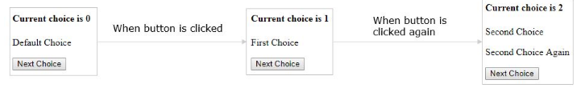
Output:

Slide 80
Custom Structural Directive
You can create custom structural directives when there is no built-in directive available for the required functionality.
Example:
Problem Statement: Create a custom structural directive called 'repeat' which should repeat the element given a number of times. As there is no built-in directive available to implement this, a custom directive can be created.

Slide 81
To create a custom structural directive, create a class annotated with @Directive
@Directive({
})
class MyDirective{}
Generate a directive called 'repeat' using the following command
D:\MyApp>ng generate directive repeat

Slide 82
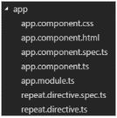
This will create two files under the src\app folder with names repeat.directive.ts and repeat.directive.spec.ts (this is for testing). Now the app folder structure will look as shown below:
It also adds repeat directive to the root module i.e., app.module.ts to make it available to the entire module as shown below in Line 7

Slide 83
app.module.ts
...
import { RepeatDirective } from './repeat.directive';
@NgModule({
declarations: [
AppComponent,
RepeatDirective
],
...
})
export class AppModule { }

Slide 84
Open repeat.directive.ts file and add the following code
import { Directive, TemplateRef, ViewContainerRef, Input } from '@angular/core';
@Directive({
selector: '[appRepeat]'
})
export class RepeatDirective {
constructor(private templateRef: TemplateRef<any>, private viewContainer: ViewContainerRef) { }
@Input() set appRepeat(count: number) {
for (let i = 0; i < count; i++) {
this.viewContainer.createEmbeddedView(this.templateRef);
}
}
}

Slide 85
Line 3: Annotate the class with @Directive which represents the class as a directive and specify the selector name inside brackets
Line 8: Create a constructor and inject two classes called TemplateRef which acquires <ng-template> content and another class called ViewcontainerRef which access the HTML container to add or remove elements from it

Slide 86
Line 10: Create a setter method for an appRepeat directive by attaching @Input() decorator which specifies that this directive will receive value from the component. This method takes the number passed to the appRepeat directive as an argument.
Line 12: As we need to render the elements based on the number passed to the appRepeat directive, run a for loop in which pass the template reference to a createEmbeddedView method which renders the elements into the DOM. This structural directive creates an embedded view from the Angular generated <ng-template> and inserts that view in a view container.

Slide 87
app.component.html
<h3>Structural Directive</h3>
<p *appRepeat="5">I am being repeated...</p>
Line 2: appRepeat directive is applied to the paragraph element. It will render five paragraph elements into the DOM.

Slide 88
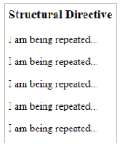
Output:

Slide 89
Attribute Directives
Attribute directives change the appearance/behavior of a component/element.
Following are built-in attribute directives:
ngStyle
ngClass
ngStyle:
This directive is used to modify a component/element’s style. You can use the following syntax to set a single CSS style to the element which is also known as style binding
[style.<cssproperty>] = "value"

Slide 90
Example:
app.component.ts
...
export class AppComponent {
colorName = 'yellow';
color = 'red';
}
Line 3-4: colorName and color properties are initialized to default values

Slide 91
app.component.html
<div [style.background-color]="colorName" [style.color]="color">
Uses fixed yellow background
</div>
Line 1: style.background-color will set the background-color of the text to yellow and style.color directive will set the color of the text to red.

Slide 92

Output:
If there are more than one CSS styles to apply, you can use ngStyle attribute.
Example:
app.component.ts
...
export class AppComponent {
colorName = 'red';
fontWeight = 'bold';
borderStyle = '1px solid black';
}
Line3-5: Create three properties called colorName, fontWeight and borderStyle and initialize them with some default values

Slide 93
app.component.html
<p [ngStyle]="{
color:colorName,
'font-weight':fontWeight,
borderBottom: borderStyle
}">
Demo for attribute directive ngStyle
</p>
Line 1-5: ngStyle directive is used here to set multiple CSS styles for the given text

Slide 94

Output:

Slide 95
ngClass
It allows you to dynamically set and change the CSS classes for a given DOM element. Use the following syntax to set a single CSS class to the element which is also known as class binding.
[class.<css_class_name>] = "property/value"
Example:
app.component.ts
...
export class AppComponent {
isBordered = true;
}
Line 3: Create a Boolean property called isBordered and initialize it to true

Slide 96
app.component.html
<div [class.bordered]="isBordered">
Border {{ isBordered ? "ON" : "OFF" }}
</div>
Line 1: Bind the isBordered property with the CSS class bordered. Bordered CSS class will be applied only if isBordered property evaluates to true.

Slide 97
In app.component.css, add the following CSS class
.bordered {
border: 1px dashed black;
background-color: #eee;
}

Slide 98

Output:
If you have more than one CSS classes to apply, then you can go for ngClass syntax.
Syntax:
[ngClass] = "{css_class_name1 : Boolean expression, css_class_name2: Boolean expression, ……}"

Slide 99
Example:
app.component.ts
...
export class AppComponent {
isBordered = true;
isColor = true;
}
Line 3-4: Two Boolean properties called isBordered and isColor are initialized to true

Slide 100
app.component.html
<div [ngClass]="{bordered: isBordered, color: isColor}">
Border {{ isBordered ? "ON" : "OFF" }}
</div>
Line 1: Two CSS classes called bordered and color are applied to a div tag. Both the classes are binded with isBordered and isColor properties where the CSS classes will be applied to div tag only if the properties return true

Slide 101
Add the following CSS classes in app.component.css
.bordered {
border: 1px dashed black;
background-color: #eee;
}
.color {
color: blue;
}

Slide 102

Output:

Slide 103
Custom Attribute Directive
You can create a custom attribute directive when there is no built-in directive available for the required functionality.
Problem Statement: Create an attribute directive called 'showMessage' which should display the given message in a paragraph when a user clicks on it and should change the text color to red. As there is no built-in directive available to implement this functionality, you need to go for a custom directive.

Slide 104
To create a custom attribute directive, we need to create a class annotated with @Directive
@Directive({
})
class MyDirective { }
Example:
Generate a directive called 'message' using the following command
D:\MyApp> ng generate directive message

Slide 105
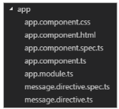
This will create two files under the src\app folder with the names message.directive.ts and message.directive.spec.ts (this is for testing). Now the app folder structure will look as shown below:

Slide 106
It also adds message directive to the root module i.e., app.module.ts to make it available to the entire module as shown below
...
import { MessageDirective } from './message.directive';
@NgModule({
declarations: [
AppComponent,
MessageDirective
],
...
})
export class AppModule { }

Slide 107
Open the message.directive.ts file and add the following code:
import { Directive, ElementRef, Renderer2, HostListener, Input } from '@angular/core';
@Directive({
selector: '[appMessage]',
})
export class MessageDirective {
@Input('appMessage') message!: string;
constructor(private el: ElementRef, private renderer: Renderer2) {
renderer.setStyle(el.nativeElement, 'cursor', 'pointer');
}
@HostListener('click') onClick() {
this.el.nativeElement.innerHTML = this.message;
this.renderer.setStyle(this.el.nativeElement, 'color', 'red');
}
}

Slide 108
Line 3: Create a directive class with the selector name as appMessage
Line 8: @Input('appMessage') will inject the value passed to 'appMessage' directive into the 'message' property
Line10: Use constructor injection to inject ElementRef which holds the HTML element reference in which directive is used and Renderer2 which is used to set the CSS styles.
Line 11: Using Renderer2 reference, the cursor is being changed to pointer symbol
Line 14-16: onClick method is invoked when the click event is triggered on the directive which will display the message received and changes the element color to red.

Slide 109
app.component.ts
import { Component } from '@angular/core';
@Component({
selector: 'app-root',
templateUrl: './app.component.html',
styleUrls: ['./app.component.css']
})
export class AppComponent {
myMessage="Hello, I am from attribute directive"
}

Slide 110
app.component.html
<h3>Attribute Directive</h3>
<p [appMessage]="myMessage">Click Here</p>
Line 2: Apply appMessage directive by assigning 'myMessage' property which will be sent to the directive on click of the paragraph

Slide 111
Add the following CSS styles to the app.component.css file
h3 {
color: #369;
font-family: Arial, Helvetica, sans-serif;
font-size: 250%;
}
p {
color: #ff0080;
font-family: Arial, Helvetica, sans-serif;
font-size: 150%;
}

Slide 112
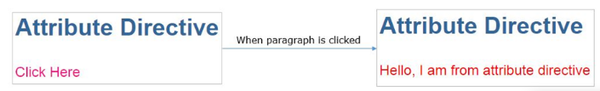
Output:

Slide 113
Understanding Data Binding
Data Binding is a mechanism where data in view and model are in sync. Users should be able to see the same data in a view which the model contains.
As a developer, you need to bind the model data in a template such that the actual data reflects in the view.
There are two types of data bindings based on the direction in which data flows.
One-way Data Binding
Two-way Data Binding

Slide 114
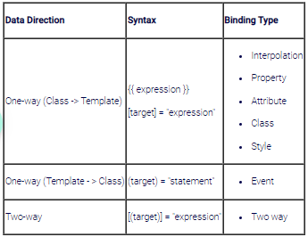

Slide 115
target in the above table refers to a property/event/attribute-name(rarely used).
One-way Data Binding
The following are one-way data binding types:
Property Binding
Attribute Binding
Class Binding
Style Binding
Event Binding

Slide 116
Property Binding
Property binding is used when its requried to set the property of a class with the property of an element
Syntax:
<img [src] = 'imageUrl' />
or
<img bind-src = 'imageUrl' />
Here the component's imageUrl property is bound to the value to the image element's property src.

Slide 117
Interpolation can be used as an alternative to property binding. Property binding is mostly used when it is required to set a non-string value.
Example:
First, create a folder called 'imgs' under the assets folder and copy any image into that folder.
app.component.ts
...
export class AppComponent {
imgUrl: string = 'assets/imgs/logo.jpg';
}
Line 3: Create a property called imgUrl and initialize it to the image path

Slide 118
app.component.html
<img [src]='imgUrl' width=200 height=100>
Line 1: Bind imgUrl property with src property. This is called property binding
Note: this can also be written as:
<img bind-src='imgUrl' width=200 height=100>

Slide 119
Attribute Binding
Property binding will not work for a few elements/pure attributes like ARIA, SVG, and COLSPAN. In such cases, you need to go for attribute binding.
Attribute binding can be used to bind a component property to the attribute directly
For example,
<td colspan = "{{ 2+3 }}">Hello</td>
The above example gives an error as colspan is not a property. Even if you use property binding/interpolation, it will not work as it is a pure attribute. For such cases, use attribute binding.

Slide 120
Attribute binding syntax starts with prefix attr. followed by a dot sign and the name of an attribute. And then set the attribute value to an expression.
<td [attr.colspan] = "2+3">Hello</td>
Example:
app.component.ts
...
export class AppComponent {
colspanValue: string ="2";
}
Line 3: Create a property called value and initialize to 2

Slide 121
app.component.html
<table border=1>
<tr>
<td [attr.colspan]="colspanValue"> First </td>
<td>Second</td>
</tr>
<tr>
...
</tr>
</table>
Line 3: attr.colspan will inform Angular that colspan is an attribute so that the given expression is evaluated and assigned to it. This is called attribute binding.

Slide 122

Output:

Slide 123
Style Binding
Style binding is used to set inline styles. Syntax starts with prefix style, followed by a dot and the name of a CSS style property.
Syntax:
[style.styleproperty]
Example:
<button [style.color] = "isValid ? 'blue' : 'red' ">Hello</button>
Here button text color will be set to blue if the expression is true, otherwise red.

Slide 124
Some style bindings will have a unit extension.
Example:
<button [style.font-size.px] = "isValid ? 3 : 6">Hello</button>
Here text font size will be set to 3 px if the expression isValid is true, otherwise, it will be set to 6px.
The ngStyle directive is preferred when it is required to set multiple inline styles at the same time.

Slide 125
Event Binding
User actions such as entering text in input boxes, picking items from lists, button clicks may result in a flow of data in the opposite direction: from an element to the component.
Event binding syntax consists of a target event with ( ) on the left of an equal sign and a template statement on the right.
Example:
<button (click) ="onSubmit(username.value,password.value)">
Login</button>
OR
<button on-click = "onSubmit(username.value,password.value)">Login</button>

Slide 126
Built-in Pipes
Why Pipes?
Pipes provide a beautiful way of transforming the data inside templates, for the purpose of display.
Pipes in Angular
Pipes in Angular take an expression value as an input and transform it into the desired output before displaying it to the user. It provides a clean and structured code as you can reuse the pipes throughout the application, while declaring each pipe just once.
Syntax:
{{ expression | pipe }}
Example:
{{ "Angular" | uppercase }}
This will display ANGULAR

Slide 127
Various built-in pipes are provided by Angular for data transformations like transformation of numerical values, string values, dates, etc.. Angular also has built-in pipes for transformations for internationalization (i18n), where locale information is used for data formatting.
The following are commonly used built-in pipes for data formatting:
uppercase
lowercase
titlecase
currency
date
percent
slice
decimal

Slide 128
uppercase
This pipe converts the template expression into uppercase.
Syntax:
{{ expression | uppercase }}
Example:
{{ "Laptop" | uppercase }}
Output:
LAPTOP
lowercase
This pipe converts the template expression into lowercase.
Syntax:
{{ expression | lowercase }}
Example:
{{ "LAPTOP" | lowercase }}
Output:
laptop

Slide 129
titlecase
This pipe converts the first character in each word of the given expression into a capital letter.
Syntax:
{{ expression | titlecase }}
Example:
{{ "product details" | titlecase }}
Output:
Product Details

Slide 130
Passing parameters to Pipes
Built-in Pipes with Parameters:
A pipe can also have optional parameters to change the output. To pass parameters, after a pipe name add a colon( : ) followed by the parameter value.
Syntax:
pipename : parametervalue
A pipe can also have multiple parameters as shown below
pipename : parametervalue1:parametervalue2
Below are the built-in pipes present in Angular, which accept optional parameters using which the pipe's output can be fine-tuned.

Slide 131
currency
This pipe displays a currency symbol before the expression. By default, it displays the currency symbol $
Syntax:
{{ expression | currency:currencyCode:symbol:digitInfo:locale }}
currencyCode is the code to display such as INR for the rupee, EUR for the euro, etc.
symbol is a Boolean value that represents whether to display currency symbol or code.
symbol (default): displays symbol such as $ etc.
symbol-narrow: displays the narrow symbol of currency. Some countries have two symbols for their currency, regular and narrow. For example, the Canadian Dollar CAD has the symbol as CA$ and symbol-narrow as $.

Slide 132
digitInfo is a string in the following format
{minIntegerDigits}.{minFractionDigits} - {maxFractionDigits}
minIntegerDigits is the minimum integer digits to display. The default value is 1
minFractionDigits is the minimum number of digits to display after the fraction. The default value is 0
maxFractionDigits is the maximum number of digits to display after the fraction. The default value is 3
locale is used to set the format followed by a country/language. To use a locale, the locale needs to be registered in the root module.

Slide 133
For Example,to set locale to French (fr), add the below statements in app.module.ts
import { registerLocaleData } from '@angular/common';
import localeFrench from '@angular/common/locales/fr';
registerLocaleData(localeFrench);
Examples:
{{ 25000 | currency }} will display $25,000.00
{{ 25000 | currency:'CAD' }} will display CA$25,000.00
{{ 25000 | currency:'CAD':'code' }} will display CAD25,000.00
{{ 25000 | currency:'CAD':'symbol':'6.2-3'}} will display CA$025,000.00
{{ 25000 | currency:'CAD': 'symbol-narrow':'1.3'}} will display $25,000.000
{{ 250000 | currency:'CAD':'symbol':'6.3'}} will display CA$250,000.000
{{ 250000 | currency:'CAD':'symbol':'6.3':'fr'}} will display 250 000,000 CA$

Slide 134
date
This pipe can be used to display the date in the required format
Syntax:
{{ expression | date:format:timezone:locale }}
An expression is a date or number in milliseconds
The format indicates in which form the date/time should be displayed. Following are the pre-defined options for it.
'medium' :equivalent to 'MMM d, y, h:mm:ss a' (e.g. Jan 31, 2018, 11:05:04 AM)
'short': equivalent to 'M/d/yy, h:mm a' (e.g. 1/31/2018, 11:05 AM)
'long': equivalent to 'MMMM d, y, h:mm:ss a z' (e.g. January 31, 2018 at 11:05:04 AM GMT+5)
'full': equivalent to 'EEEE, MMMM d, y, h:mm:ss a zzzz' (e.g. Wednesday, January 31, 2018 at 11:05:04 AM GMT+05:30)
'fullDate' : equivalent to 'EEEE, MMMM d, y' (e.g. Wednesday, January 31, 2018)

Slide 135
'longDate' : equivalent to 'MMMM d, y' (e.g. January 31, 2018)
'mediumDate' : equivalent to 'MMM d, y' (e.g. Jan 31, 2018)
'shortDate' : equivalent to 'M/d/yy' (e.g. 1/31/18)
'mediumTime' : equivalent to 'h:mm:ss a' (e.g. 11:05:04 AM)
'shortTime' : equivalent to 'h:mm a' (e.g. 11:05 AM)
'longTime': equivalent to 'h:mm a' (e.g. 11:05:04 AM GMT+5)
'fullTime': equivalent to 'h:mm:ss a zzzz' (e.g. 11:05:04 AM GMT+05:30)

Slide 136
Timezone to be used for formatting. For example, ’+0430’ (4 hours, 30 minutes east of the Greenwich meridian) If not specified, the local system timezone of the end-user's browser will be used.
locale is used to set the format followed by a country/language. To use a locale, register the locale in the root module.
For Example, to set locale to French (fr), add the below statements in app.module.ts
import { registerLocaleData } from '@angular/common';
import localeFrench from '@angular/common/locales/fr';
registerLocaleData(localeFrench);

Slide 137
Examples:
{{ "6/2/2017" | date }} will display Jun 2, 2017
{{ "6/2/2017, 11:30:45 AM" | date:'medium' }} will display Jun 2, 2017, 11:30:45 AM
{{ "6/2/2017, 11:30:45 AM" | date:'mmss' }} will display 3045
{{"1/31/2018, 11:05:04 AM" | date:'fullDate':'0':'fr'}} will display mercredi 31 janvier 2018
{{ 90000000 | date }} will display Jan 2, 1970 – date pipe will start from Jan 1, 1970 and based on the given number of milliseconds, it displays the date

Slide 138
percent
This pipe can be used to display the number as a percentage
Syntax:
{{ expression | percent:digitInfo:locale }}
digitInfo is a string in the following format
{minIntegerDigits}.{minFractionDigits} - {maxFractionDigits}
minIntegerDigits is the minimum integer digits to display. The default value is 1
minFractionDigits is the minimum number of digits to display after the fraction. The default value is 0.
maxFractionDigits is the maximum number of digits to display after the fraction. The default value is 3.

Slide 139
locale is used to set the format followed by a country/language. To use a locale, register the locale in the root module.
For Example, to set locale to French (fr), add the below statements in app.module.ts
import { registerLocaleData } from '@angular/common';
import localeFrench from '@angular/common/locales/fr';
registerLocaleData(localeFrench);
Examples:
{{ 0.1 | percent }} will display 10%
{{ 0.1 | percent:'2.2-3' }} will display 10.00%
{{ 0.1 | percent:'2.2-3': 'fr' }} will display 10.00 %

Slide 140
slice
This pipe can be used to extract a subset of elements or characters from an array or string respectively.
Syntax:
{{ expression | slice:start:end }}
The expression can be an array or string
start represents the starting position in an array or string to extract items. It can be a
positive integer which will extract from the given position till the end
negative integer which will extract the given number of items from the end
end represents the ending position in an array or string for extracting items. It can be
positive number that returns all items before the end index
negative number which returns all items before the end index from the end of the array or string

Slide 141
Examples:
{{ ['a','b','c','d']| slice:2}} will display c,d
{{ ['a','b','c','d']| slice:1:3}} will display b,c
{{ 'Laptop Charger'| slice:3:6}} will display top
{{ 'Laptop Charger'| slice:-4}} will display rger
{{ 'Laptop Charger'| slice:-4:-2}} will display rg
number
This pipe can be used to format a number.
Syntax:
{{ expression | number:digitInfo }}

Slide 142
The expression should be numeric
digitInfo is a string in the following format
{minIntegerDigits}.{minFractionDigits} - {maxFractionDigits}
minIntegerDigits is the minimum integer digits to display. The default value is 1.
minFractionDigits is the minimum number of digits to display after the fraction. The default value is 0.
maxFractionDigits is the maximum number of digits to display after fraction. The default value is 3.
Example:
{{ 25000 | number }} will display 25,000
{{ 25000 | number:'.3-5' }} will display 25,000.000

Slide 143
Nested Components
Nested component is a component that is loaded into another component
The component where another component is loaded onto is called a container component/parent component.
The root component is loaded in the index.html page using its selector name. Similarly, to load one component into a parent component, use the selector name of the component in the template i.e., the HTML page of the container component

Slide 144
Example for creating multiple components and load one into another:
Problem Statement: Create an AppComponent which displays a button to view courses list on click of it and another component called CoursesListComponent which displays courses list. When the user clicks on the button in the AppComponent, it should load the CoursesList component within it to show the courses list.

Slide 145
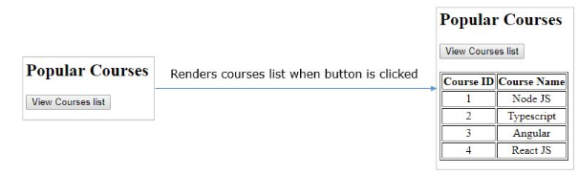

Slide 146
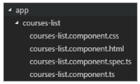
Create a component called the coursesList using the following CLI command
D:\MyApp>ng generate component coursesList
This command will create four files called courses-list.component.ts, courses-list.component.html, courses-list.component.css, courses-list.component.spec.ts and places them inside a folder called courses-list under the app folder as shown below.

Slide 147
This command will also add the CoursesList component to the root module.
app.module.ts
...
import { CoursesListComponent } from './courses-list/courses-list.component';
@NgModule({
declarations: [
AppComponent,
CoursesListComponent
],
...
})
export class AppModule { }
Line 7: CoursesListComponent is added to the declarations property to make it available to all other components in the module.

Slide 148
courses-list.component.ts
...
export class CoursesListComponent {
courses = [
{ courseId: 1, courseName: 'Node JS' },
{ courseId: 2, courseName: 'Typescript' },
{ courseId: 3, courseName: 'Angular' },
{ courseId: 4, courseName: 'React JS' }
];
}
Line 3-8: courses is an array of objects where each object has properties called courseId and courseName

Slide 149
courses-list.component.html
<table border="1">
...
<tbody>
<tr *ngFor="let course of courses">
<td>{{course.courseId}}</td>
<td>{{course.courseName}}</td>
</tr>
</tbody>
</table>
Line 4-7: ngFor iterates over courses array and renders courseId and courseName values

Slide 150
Add the following code in courses-list.component.css
tr{
text-align:center;
}
Line 1-3: adds center alignment to a table row in an HTML page

Slide 151
app.component.html
...
<button (click)="show=true">View Courses list</button><br/><br/>
<div *ngIf="show">
<app-courses-list></app-courses-list>
</div>
Line 2: click event is bounded to button which will initialize show property to true when it is clicked
Line 4: It loads the CoursesList component only if the show property value is true.

Slide 152
Note:
Here AppComponent is called Parent component or container component as we are loading another component in it.
CoursesList component is called child component as it is being loaded in another component.

Slide 153
Passing data from Container Component to Child Component
Component communication is needed if data needs to be shared between the components
In order to pass data from container/parent component to child component, @Input decorator can be used.
A child component can use @Input decorator on any property type like arrays, objects, etc. making it a data-bound input property.
The parent component can pass value to the data-bound input property when rendering the child within it.

Slide 154
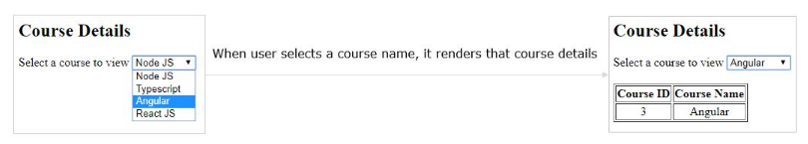
Example:
Problem Statement: Create an AppComponent that displays a dropdown with a list of courses as values in it. Create another component called CoursesList component and load it in AppComponent which should display the course details. When a user selects a course from the dropdown, corresponding course details should be loaded

Slide 155
Open the courses-list.component.ts file
Add input setter method for property cName in the component
...
export class CoursesListComponent {
...
course!: any[];
@Input() set cName(name: string) {
this.course = [];
for (var i = 0; i < this.courses.length; i++) {
if (this.courses[i].courseName === name) {
this.course.push(this.courses[i]);
}
}
}
}
Line 5: @Input() specifies that cName property will receive value from its container component
Line 7-11: for loop will iterate over courses array and it checks for the courseName validity. If it matches, it adds that object to the course array

Slide 156
courses-list.component.html
<table border="1" *ngIf="course.length>0">
...
<tbody>
<tr *ngFor="let c of course">
<td>{{c.courseId}}</td>
<td>{{c.courseName}}</td>
</tr>
</tbody>
</table>
Line 4-7: ngFor iterates on course array and displays courseId and courseName properties in a table

Slide 157
Add the following code in app.component.html
<h2>Course Details</h2>
Select a course to view
<select #course (change)="name = course.value">
<option value="Node JS">Node JS</option>
<option value="Typescript">Typescript</option>
<option value="Angular">Angular</option>
<option value="React JS">React JS </option></select> <br /><br />
<app-courses-list [cName]="name"></app-courses-list>

Slide 158
Line 2-7: It displays a drop-down to select a course to display its details. When the user selects a value, it assigns the selected value to the name property.
Line 9: This will load CoursesListComponent and passes the name property value to the cName property of CoursesListComponent class.

Slide 159
Passing data from Child to Container Component
If a child component wants to send data to its parent component, then it must create a property with @Output decorator.
The only method for the child component to pass data to its parent component is through events. The property must be of type EventEmitter
Example:
Problem Statement: Create an AppComponent that loads another component called CoursesList component. Create another component called CoursesListComponent which should display the courses list in a table along with a register button in each row. When a user clicks on the register button, it should send that courseName value back to AppComponent where it should display the registration successful message along with courseName

Slide 160
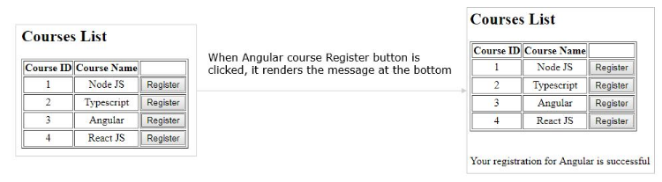

Slide 161
courses-list.component.ts
...
export class CoursesListComponent {
@Output() onRegister = new EventEmitter<string>();
...
register(courseName: string) {
this.onRegister.emit(courseName);
}
}
Line 3: Create a property called onRegister of type EventEmitter and attach @Output decorator which makes the property to send the data from child to parent.
Line 7: this line emits the courseName value i.e, send the courseName value back to parent component.

Slide 162
courses-list.component.html
<table border="1">
...
<tbody>
<tr *ngFor="let course of courses">
<td>{{course.courseId}}</td>
<td>{{course.courseName}}</td>
<td><button (click)="register(course.courseName)">Register
</button></td>
</tr>
</tbody>
</table>
Line 7: When the user clicks this button, it invokes the register method by passing courseName value.

Slide 163
app.component.html
<h2> Courses List </h2>
<app-courses-list (OnRegister)="courseReg($event)"></app-courses-list>
<br/><br/>
<div *ngIf="message">{{message}}</div>
Line 3: Binds onRegister event with courseReg method of the parent component. When CoursesListComponent emits the value, onRegister event is triggered and it invokes courseReg method. $event holds the value emitted by CoursesListComponent
Line 6: This renders the message property value which holds the value emitted.

Slide 164
app.component.ts
...
export class AppComponent {
message!: string;
courseReg(courseName: string) {
this.message = `Your registration for ${courseName} is successful`;
}
}
Line 6: courseReg method is invoked when onRegister event emits
Line 7: Assigns the string to message property which will be rendered in the template

Slide 165
Shadow DOM
Shadow DOM is a web components standard by W3C.
It enables encapsulation for DOM tree and styles.
Shadow DOM hides DOM logic behind other elements and confines styles only for that component.
For example, in an Angular application, n number of components will be created and each component will have its own set of data and CSS styles.

Slide 166
When these are integrated, there is a chance that the data and styles may be applied to the entire application. Shadow DOM encapsulates data and styles for each component to not flow through the entire application.
In the below example shown, each component is having its own styles defined and they are confined to themselves:

Slide 167
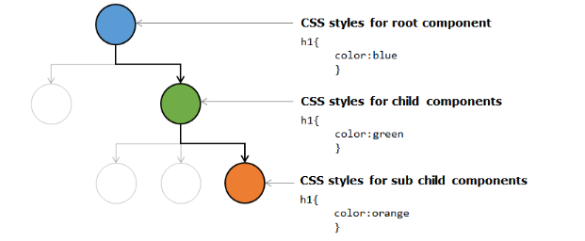

Slide 168
Component Life Cycle
A component has a life cycle that is managed by Angular. It includes creating a component, rendering it, creating and rendering its child components, checks when its data-bound properties change, and destroy it before removing it from the DOM.
Angular has some methods/hooks which provide visibility into these key life moments of a component and the ability to act when they occur.
Following are the lifecycle hooks of a component. The methods are invoked in the same order as mentioned in the table below:

Slide 169
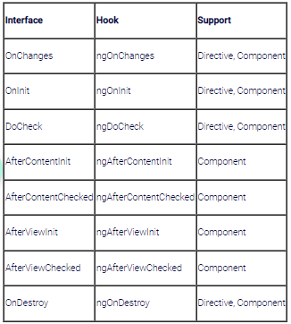

Slide 170
Syntax
import { Component, OnInit, DoCheck, AfterContentInit, AfterContentChecked,
AfterViewInit, AfterViewChecked, OnDestroy } from '@angular/core';
...
export class AppComponent implements OnInit, DoCheck, AfterContentInit, AfterContentChecked,
AfterViewInit, AfterViewChecked, OnDestroy {
ngOnInit() { }
ngDoCheck() { }
ngAfterContentInit() { }
ngAfterContentChecked() { }
ngAfterViewInit() { }
ngAfterViewChecked() { }
ngOnDestroy() { }
}

Slide 171
Line 1: Import the interfaces of lifecycle hooks
Line 4-5: Inherit interfaces that have life cycle methods to override
Line 6-12: Override all lifecycle hooks

Slide 172
Lifecycle Hooks
ngOnChanges – It gets invoked when Angular sets data-bound input property i.e., the property attached with @Input(). This will be invoked whenever input property changes its value
ngOnInit – invoked when Angular initializes the directive or component
ngDoCheck - invoked for every change detection in the application
ngAfterContentInit –invoked after Angular projects content into its view
ngAfterContentChecked –invoked after Angular checks the bindings of the content it projected into its view
ngAfterViewInit –invoked after Angular creates component’s views
ngAfterViewChecked –invoked after Angular checks the bindings of the component’s views
ngOnDestroy –invoked before Angular destroys directive or component

Slide 173
Example:
app.component.ts
import {
Component, OnInit, DoCheck, AfterContentInit, AfterContentChecked,
AfterViewInit, AfterViewChecked,
OnDestroy
} from '@angular/core';
@Component({
selector: 'app-root',
styleUrls: ['./app.component.css'],
templateUrl: './app.component.html'
})
export class AppComponent implements OnInit, DoCheck,
AfterContentInit, AfterContentChecked,
AfterViewInit, AfterViewChecked,
OnDestroy {
data = 'Angular';
ngOnInit() {
console.log('Init');
}

Slide 174
ngDoCheck(): void {
console.log('Change detected');
}
ngAfterContentInit(): void {
console.log('After content init');
}
ngAfterContentChecked(): void {
console.log('After content checked');
}
ngAfterViewInit(): void {
console.log('After view init');
}
ngAfterViewChecked(): void {
console.log('After view checked');
}
ngOnDestroy(): void {
console.log('Destroy');
}
}

Slide 175
Line 11-14: Inherit all lifecycle interfaces
Line 16-36: Override all the lifecycle methods and logging a message
Note: ngOnInit() is the first method to be invoked for AppComponent. Whenever data property value changes it invokes the ngDoCheck() method. All Init methods gets invoked only once at the beginning and from later whenever a change happens Angular invokes ngDoCheck, ngAfterContentChecked and ngAfterViewChecked methods

Slide 176
child.component.ts
...
export class ChildComponent implements OnChanges {
@Input() title: string = 'I\'m a nested component';
ngOnChanges(changes: any): void {
console.log('changes in child:' + JSON.stringify(changes));
}
}
Line 3: title is an input property that receives value from App component
Line 4: Override ngOnChanges method which gets invoked whenever input property changes its value.

Slide 177
app.component.html
<div>
<h1>I'm a container component</h1>
<input type="text" [(ngModel)]='data'>
<app-child [title]='data'></app-child>
</div>
Line 3: textbox is bound with the data property
Line 4: Loads child component and data property is bound with the title property of the child component

Slide 178
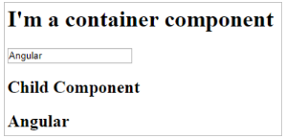
child.component.html
<h2>Child Component</h2>
<h2>{{title}}</h2>
Output:

Slide 179
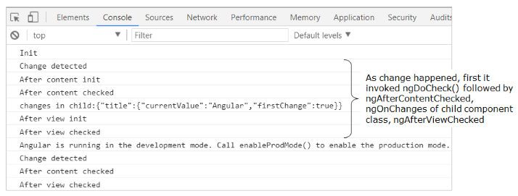
Browser Console:

Slide 180
Forms in Angular
Introduction to Forms in Angular:
Forms enable users to provide data input into the application in contexts like performing user registration, user sign-in, updating profile, entering sensitive information like payment information and for performing other data-entry based tasks.
Forms in Angular:
Angular has two different approaches in dealing with forms: reactive forms and template-driven forms.

Slide 181
Both reactive forms and template-driven forms:
can capture user-provided data,
can capture user input events,
can validate the user input, etc.
have their own approaches of processing and managing the form data:
In template-driven forms, you will create the form completely in the template and need to rely on directives to create and manipulate the underlying form object model.
The template-driven forms are more suitable only when you want to add a simple small form to the application. For example: a signup form.

Slide 182
In reactive forms, you can control the form completely from the component class and hence you will get direct, explicit access to the underlying forms object model.
Hence, reactive forms are also known as 'model-driven forms'.
As reactive forms are more robust and scalable, they are more suitable for creating all kind of forms in an application, irrespective of the size of form.

Slide 183
State of forms and form controls in Angular:
Angular automatically tracks the changes happening to the form and form controls as and when user provides input and thereby controls the state and the validity of the form/form controls.
Angular does this by associating respective keywords automatically for the forms/form controls depending on the context.
The below table describes the details:

Slide 184
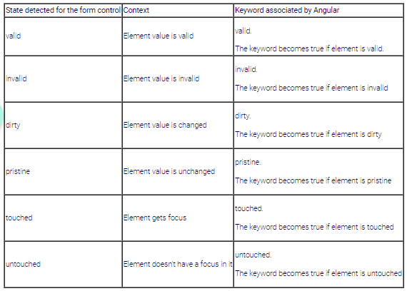

Slide 185
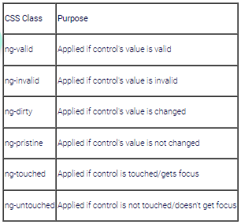
Angular also has the following built-in CSS classes which get auto-applied depending on the state.

Slide 186
Advantages of Reactive Forms/ Model Driven Forms
Unit testing on the validation logic can be performed, as it is written inside the component class.
Form changes or events can be heard easily using reactive forms. Each FormGroup or FormControl has few events like valueChanges, statusChanges, etc.,
Reactive forms are used in creating medium to large scale applications
Due to the advantages of Reactive forms, in most Angular applications, Reactive Forms Approach is chosen when creating forms.

Slide 187
Creating Reactive Forms in Angular
Step1:
To create a reactive form in Angular, FormBuilder class must be used. To make the FormBuilder class available, ReactiveFormsModule has to be imported in the root module.
Register the ReactiveFormsModule during bootstrapping, in the app.module.ts
import { BrowserModule } from '@angular/platform-browser';
import { NgModule } from '@angular/core';
import { ReactiveFormsModule } from '@angular/forms';
import { AppComponent } from './app.component';
import { RegistrationFormComponent } from './registration-form/registration-form.component';
@NgModule({
declarations: [
AppComponent,
RegistrationFormComponent ] ,

Slide 188
imports: [
BrowserModule,
ReactiveFormsModule
],
providers: [],
bootstrap: [AppComponent]
})
export class AppModule { }

Slide 189
Line 3: Import ReactiveFormsModule from @angular/forms module
Line 15: Add ReactiveFormsModule in the imports declaration to create reactive forms
Step 2: Create a component called RegistrationForm using the following CLI command.
ng generate component RegistrationForm

Slide 190
Step 3:
Add the below to app.component.html
<app-registration-form></app-registration-form>
Line 1: Loads RegistrationFormComponent in the root component
Step 4:
Bootstrap CSS framework (v3) is commonly used for adding basic structural layout and style for web applications. For structuring the RegistrationForm in this example, CSS classes from the Bootstrap CSS framework can be used.
To add Bootstrap CSS library to the application, install bootstrap as shown below:
npm install bootstrap@3.3.7 --save

Slide 191
Then, include boostrap.min.css file in angular.json file as shown below:
...
"styles": [
"src/styles.css",
"node_modules/bootstrap/dist/css/bootstrap.min.css"
],
"scripts": [
"node_modules/jquery/dist/jquery.min.js",
"node_modules/bootstrap/dist/js/bootstrap.min.js"
]
...
Note: When angular.json is modified, restart the server to see the changes reflected.

Slide 192
Step 5:
Include the below code to registration-form.component.css
.ng-valid[required] {
border-left: 5px solid #42A948; /* green */
}
.ng-invalid:not(form) {
border-left: 5px solid #a94442; /* red */
}
Line 1-3: ng-valid CSS class changes left border of the textbox to green if form control has valid input
Line 5-7: ng-invalid CSS class changes left border of the textbox to red if form control has invalid data

Slide 193
Building Reactive Forms (Angular v13)
Add the following code in the registration-form.component.ts file
import { Component, OnInit } from '@angular/core';
import { FormBuilder, FormGroup, Validators } from '@angular/forms';
@Component({
selector: 'app-registration-form',
templateUrl: './registration-form.component.html',
styleUrls: ['./registration-form.component.css']
})
export class RegistrationFormComponent implements OnInit {
registerForm!: FormGroup;
submitted!:boolean;

Slide 194
constructor(private formBuilder: FormBuilder) { }
ngOnInit() {
this.registerForm = this.formBuilder.group({
firstName: [‘ ’, Validators.required],
lastName: [‘ ’, Validators.required],
address: this.formBuilder.group({
street: [],
zip: [],
city: []
})
});
}
}

Slide 195
Line 2: Import FormBuilder class to create a reactive form. Also, import FormGroup class to create a group of form controls and Validators for validation
Line 11: Create a property registerForm of type FormGroup
Line 14: Inject a FormBuilder instance using constructor
Line 17: formBuilder.group() method creates a FormGroup. It takes an object whose keys are FormControl names and values are their definitions
Line 18-24: Create form controls such as firstName, lastName, and address as a subgroup with fields street, zip, and city. These fields are form controls.

Slide 196
For each form control:
you can mention the default value as the first argument and
the list of validators as the second argument:
Validations can be added to the form controls using the built-in validators supplied by the Validators class.
For example: Configure built-in required validator for each control using [' ', Validators.required] syntax.
If multiple validators are to be applied, then use the syntax [' ', [Validators.required, Validators.maxlength(10)]].

Slide 197
registration-form.component.html
<div class="container">
<h1>Registration Form</h1>
<form [formGroup]="registerForm">
<div class="form-group">
<label>First Name</label>
<input type="text" class="form-control" formControlName="firstName">
<div *ngIf="registerForm.controls['firstName'].errors" class="alert alert-danger">
Firstname field is invalid.
<p *ngIf="registerForm.controls['firstName'].errors?.['required']">
This field is required!
</p>
</div>
</div>

Slide 198
<div class="form-group">
<label>Last Name</label>
<input type="text" class="form-control" formControlName="lastName">
<div *ngIf="registerForm.controls['lastName'].errors" class="alert alert-danger">
Lastname field is invalid.
<p *ngIf="registerForm.controls['lastName'].errors?.['required']">
This field is required!
</p>
</div>
</div>

Slide 199
<div class="form-group">
<fieldset formGroupName="address">
<legend>Address:</legend>
<label>Street</label>
<input type="text" class="form-control" formControlName="street">
<label>Zip</label>
<input type="text" class="form-control" formControlName="zip">
<label>City</label>
<input type="text" class="form-control" formControlName="city">
</fieldset>
</div>

Slide 200
<button type="submit" class="btn btn-primary" (click)="submitted=true">Submit</button>
</form>
<br/>
<div [hidden]="!submitted">
<h3> Employee Details </h3>
<p>First Name: {{ registerForm.get('firstName')?.value }} </p>
<p> Last Name: {{ registerForm.get('lastName')?.value }} </p>
<p> Street: {{ registerForm.get('address.street')?.value }}</p>
<p> Zip: {{ registerForm.get('address.zip')?.value }} </p>
<p> City: {{ registerForm.get('address.city')?.value }}</p>
</div>
</div>

Slide 201
Line 3: formGroup is a directive that binds HTML form with the FormGroup property created inside a component class. A FormGroup has been created in component with the name registerForm. Here form tag is bound with FormGroup name called registerForm
Line 6, 16: Two text boxes for first name and last name are bound with the form controls created in the component using formControlName directive
Line 7-13: A validation error message is displayed when the firstName is modified and has validation errors.
Line 17-22: A validation error message is displayed when the lastName is modified and has validation errors.
Line 35: When the submit button is clicked, it initializes the submitted property value to true
Line 38: div tag will be hidden if the form is not submitted
Line 39-44: Using the get() method of FormGroup, each FormControl value is fetched and rendered.

Slide 202
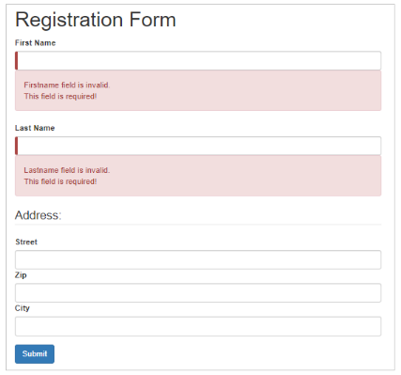
Save all the files and observe the output:

Slide 203
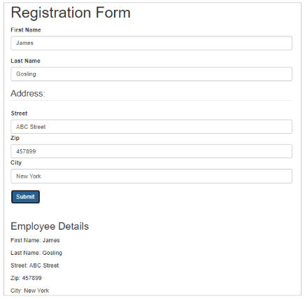

Slide 204
Custom Validation in Angular Forms
Need for custom validation:
While creating forms, there can be situations for which built-in validators are not available. Few such examples include validating a phone number, validating if the password and confirm password fields matches or not, etc.. In such situations, custom validators can be created to implement the required validation functionality.
Custom validation in Reactive Forms of Angular:
Custom validation can be applied to form controls of a Reactive Form in Angular.
Custom validators are implemented as separate functions inside the component.ts file.
these functions can be added to the list of other validators configured for a form control.

Slide 205
Implementing custom validation in Reactive Forms of Angular:
Add one more field called email inside the example used for ReactiveForms previously. The below are the validations to be applied to the 'email' field:
required,
checks for standard email pattern, for example: abc@something.com, abc@something.co.in, etc.
For implementing the for custom validation, add a separate function which checks for standard email pattern inside registration-form.component.ts as shown below:

Slide 206
import { Component, OnInit } from '@angular/core';
import { FormBuilder, FormControl, FormGroup, Validators } from '@angular/forms';
@Component({
selector: 'app-registration-form',
templateUrl: './registration-form.component.html',
styleUrls: ['./registration-form.component.css']
})
export class RegistrationFormComponent implements OnInit {
registerForm!: FormGroup;
submitted!:boolean;

Slide 207
constructor(private formBuilder: FormBuilder) { }
ngOnInit() {
this.registerForm = this.formBuilder.group({
firstName: ['', Validators.required],
lastName: ['', Validators.required],
address: this.formBuilder.group({
street: [],
zip: [],
city: []
}),
email: ['', validateEmail]
});
}
}

Slide 208
function validateEmail(c: FormControl): any {
let EMAIL_REGEXP = /^([a-zA-Z0-9_\-\.]+)@([a-zA-Z0-9_\-\.]+)\.([a-zA-Z]{2,5})$/;
return EMAIL_REGEXP.test(c.value) ? null : {
emailInvalid: {
message: "Invalid Format!"
}
};
}

Slide 209
Line 30-37: In this function, a regular expression pattern is taken for email and the input value of the form control is tested against the mentioned pattern. If the pattern matches, it means the entered input is valid and hence, the validation function returns null. Otherwise, the function returns an object with name 'emailInvalid' with one property called 'message' set to appropriate string message.
Line 21: Binds the required validator and the custom validator named validateEmail to the email field.

Slide 210
For tracking the custom validators in the Reactive Form's template (Angular v13), add HTML controls for the email field in the registration-form.component.html file as shown below:
<div class="container">
<h1>Registration Form</h1>
<form [formGroup]="registerForm">
<div class="form-group">
<label>First Name</label>
<input type="text" class="form-control" formControlName="firstName">
<div *ngIf="registerForm.controls['firstName'].errors" class="alert alert-danger">
Firstname field is invalid.
<p *ngIf="registerForm.controls['firstName'].errors?.['required']">
This field is required!
</p>
</div>
</div>

Slide 211
<div class="form-group">
<label>Last Name</label>
<input type="text" class="form-control" formControlName="lastName">
<div *ngIf="registerForm.controls['lastName'].errors" class="alert alert-danger">
Lastname field is invalid.
<p *ngIf="registerForm.controls['lastName'].errors?.['required']">
This field is required!
</p>
</div>
</div>

Slide 212
<div class="form-group">
<fieldset formGroupName="address">
<legend>Address:</legend>
<label>Street</label>
<input type="text" class="form-control" formControlName="street">
<label>Zip</label>
<input type="text" class="form-control" formControlName="zip">
<label>City</label>
<input type="text" class="form-control" formControlName="city">
</fieldset>
</div>

Slide 213
<div class="form-group">
<label>Email</label>
<input type="text" class="form-control" formControlName="email" />
<div *ngIf="registerForm.controls['email'].errors" class="alert alert-danger">
Email field is invalid.
<p *ngIf="registerForm.controls['email'].errors?.['required']">
This field is required!
</p>
<p *ngIf="registerForm.controls['email'].errors?.['emailInvalid']">
{{ registerForm.controls['email'].errors?.['emailInvalid'].message }}
</p>
</div>
</div>

Slide 214
<button type="submit" class="btn btn-primary" (click)="submitted=true">Submit</button>
</form>
<br/>
<div [hidden]="!submitted">
<h3> Employee Details </h3>
<p>First Name: {{ registerForm.get('firstName')?.value }} </p>
<p> Last Name: {{ registerForm.get('lastName')?.value }} </p>
<p> Street: {{ registerForm.get('address.street')?.value }}</p>
<p> Zip: {{ registerForm.get('address.zip')?.value }} </p>
<p> City: {{ registerForm.get('address.city')?.value }}</p>
<p>Email: {{ registerForm.get('email')?.value }}</p>
</div>
</div>

Slide 215
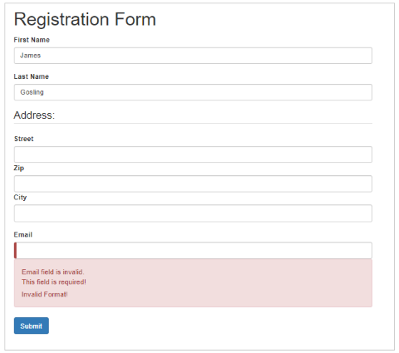
Line 44: Displays error message if email validation fails. errors object holds the error messages of all form controls
Output:

Slide 216
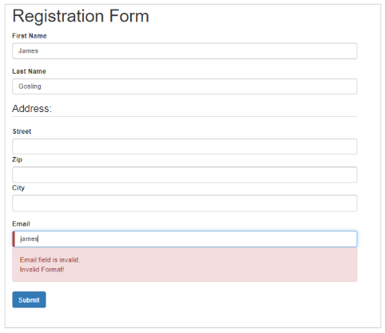

Slide 217
Dependency Injection
Dependency Injection (DI) is a mechanism where the required resources will be injected into the code automatically.
Angular comes with an in-built dependency injection subsystem.
Why Dependency Injection?
It is because DI:
allows developers to reuse the code across applications.
makes the code loosely coupled.
makes application development and testing much easier.
allows the developer to ask for the dependencies from Angular. There is no need for the developer to explicitly create/instantiate them.

Slide 218
Services Basics
A service in Angular is a class that contains some functionality that can be reused across the application.
Angular Services come as objects which are wired together using dependency injection.
Angular provides a few inbuilt services also can create custom services.
Why Services?
Services can be used to:
share the code across components of an application.
make HTTP requests.

Slide 219
Creating a Service
To create a service class, use the following command:
ng generate service book
The above command will create a service class as shown below:
@Injectable({
providedIn:'root'
})
export class BookService
{
}
@Injectable() decorator makes the class injectable into application components.

Slide 220
Providing a Service
1. The first way to register service is to specify providedIn property using @Injectable decorator. This property is added by default when you generate a service using Angular CLI.
import { Injectable } from '@angular/core';
@Injectable({
providedIn: 'root'
})
export class BookService {}
Line 4: providedIn property registers BookService at the root level (app module).
When the BookService is provided at the root level, Angular creates a singleton instance of the service class and injects the same instance into any class that uses this service class.

Slide 221
2. Services can also be provided across the application by registering it using the providers property in the @Ngmodule decorator of any module.
@NgModule({
imports: [BrowserModule],
declarations: [AppComponent, BookComponent],
providers: [BookService],
bootstrap: [AppComponent]
})
Line 4: When the service class is added in the providers property of the root module, all the directives and components will have access to the same instance of the service.

Slide 222
3. There is also a way to limit the scope of the service class by registering it in the providers' property inside the @Component decorator. Providers in component decorator and module decorator are independent. Providing a service class inside a component creates a separate instance for that component and its nested components.
import { BookService } from './book/book.service';
@Component({
selector: 'app-root',
styleUrls: ['./app.component.css'],
templateUrl: './app.component.html',
providers:[BookService]
})

Slide 223
Injecting a Service
The only way to inject a service into a component/directive or any other class is through a constructor.
Add a constructor in a component class with service class as an argument as shown below:
constructor(private bookService: BookService){ }
BookService will then be injected into the component through constructor injection by the framework.

Slide 224
RxJS Observables
Reactive Extensions for JavaScript (RxJS) is a third-party library used by the Angular team.
RxJS is used to work with asynchronous streams of data.
Observables, in RxJS, are used to represent asynchronous streams of data. Observables are a more advanced version of Promises in JavaScript

Slide 225
Why RxJS Observables?
Angular team has recommended Observables for asynchronous calls because of the following reasons:
Promises emit a single value whereas observables (streams) emit many values
Observables can be cancellable where Promises are not cancellable. If an HTTP response is not required, observables allow us to cancel the subscription whereas promises execute either success or failure callback even if the results are not required.
Observables support functional operators such as map, filter, reduce, etc.,

Slide 226
Create and use an observable in Angular
Example:
app.component.ts
import { Component } from '@angular/core';
import { Observable } from 'rxjs';
@Component({
selector: 'app-root',
styleUrls: ['./app.component.css'],
templateUrl: './app.component.html'
})

Slide 227
export class AppComponent {
data!: Observable<number>;
myArray: number[] = [];
errors!: boolean;
finished!: boolean;
fetchData(): void {
this.data = new Observable(observer => {
setTimeout(() => { observer.next(11); }, 1000),
setTimeout(() => { observer.next(22); }, 2000),
setTimeout(() => { observer.complete(); }, 3000);
});

Slide 228
this.data.subscribe((value) => this.myArray.push(value),
error => this.errors = true,
() => this.finished = true);
}
}

Slide 229
Line 2: imports Observable class from rxjs module
Line 11: data is of type Observable which holds numeric values
Line 16: fetchData() is invoked on click of a button
Line 17: A new Observable is created and stored in the variable data
Line 18-20: next() method of Observable sends the given data through the stream. With a delay of 1,2 and 3 seconds, a stream of numeric values will be sent. Complete() method completes the Observable stream i.e., closes the stream.
Line 22: Observable has another method called subscribe which listens to the data coming through the stream. Subscribe() method has three parameters. The first parameter is a success callback which will be invoked upon receiving successful data from the stream. The second parameter is an error callback which will be invoked when Observable returns an error and the third parameter is a complete callback which will be invoked upon successful streaming of values from Observable i.e., once complete() is invoked. After which the successful response, the data is pushed to the local array called myArray, if any error occurs, a Boolean value called true is stored in the errors variable and upon complete() will assign a Boolean value true in a finished variable.

Slide 230
app.component.html
<b> Using Observables!</b>
<h6 style="margin-bottom:0">VALUES:</h6>
<div *ngFor="let value of myArray">{{ value }}</div>
<div style="margin-bottom: 0">ERRORS: {{ errors }}</div>
<div style="margin-bottom: 0">FINISHED: {{ finished }}</div>
<button style="margin-top: 2rem" (click)="fetchData()">Fetch Data</button>

Slide 231
Line 4: ngFor loop is iterated on myArray which will display the values on the page
Line 6: {{ errors }} will render the value of errors property if any
Line 8: Displays finished property value when complete() method of Observable is executed
Line 10: Button click event is bound with fetchData() method which is invoked and creates an observable with a stream of numeric values

Slide 232
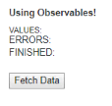
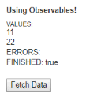
Output:

Slide 233
Server Communication using HttpClient
Most front-end applications communicate with backend services using HTTP Protocol
While making calls to an external server, the users must continue to be able to interact with the page. That is, the page should not freeze until the HTTP request returns from the external server. So, all HTTP requests are asynchronous.

Slide 234
HttpClient from @angular/common/http to communicate must be used with backend services.
Additional benefits of HttpClient include testability features, typed request and response objects, request and response interception, Observable APIs, and streamlined error handling.

Slide 235
HttpClientModule must be imported from @angular/common/http in the module class to make HTTP service available to the entire module.
Import HttpClient service class into a component’s constructor. HTTP methods like get, post, put, and delete are made used off.
JSON is the default response type for HttpClient

Slide 236
Making a GET request:
The following statement is used to fetch data from a server
this.http.get(url)
http.get by default returns an observable

Slide 237
Using Server communication in the example used for custom services:
app.module.ts
...
import { HttpClientModule } from '@angular/common/http';
...
@NgModule({
imports: [BrowserModule, HttpClientModule],
...
})
export class AppModule { }
Line 2: imports HttpClientModule from @angular/common/http module
Line 6: Includes HttpClientModule class to make use of HTTP calls

Slide 238
Add getBooks() method to BookService class in book.service.ts file as shown below
import { Injectable } from '@angular/core';
import { HttpClient, HttpErrorResponse, HttpHeaders } from '@angular/common/http';
import { Observable, throwError } from 'rxjs';
import { catchError, tap } from 'rxjs/operators';
import { Book } from './book';
@Injectable({
providedIn:'root'
})
export class BookService {
constructor(private http: HttpClient) { }
getBooks(): Observable<Book[]> {
return this.http.get<Book[]>('http://localhost:3020/bookList').pipe(
tap((data: any) => console.log('Data Fetched:' + JSON.stringify(data))),
catchError(this.handleError));
}
...
}

Slide 239
Line 13: Injects HttpClient class into a service class
Line 16-18: Makes an asynchronous call (ajax call) by using the get() method of HttpClient class.
This method makes an asynchronous call to the server URL and fetches the data.
HttpClient receives the JSON response as of type object. To know the actual structure of the response, an interface must be created and specified that interface name as a type parameter i.e., get<Book[]>.
The pipe function defines a comma-separated sequence of operators. Here a sequence of observables is defined by listing operators as arguments to pipe function instead of dot operator chaining.
The tap operator is to execute some statements once a response is ready which is mostly used for debugging purposes and catchError operator is used to handling the errors.
Line 18: handleError is an error-handling method that throws the error message back to the component

Slide 240
Error handling
What happens if the request fails on the server, or if a poor network connection prevents it from even reaching the server?
There are two types of errors that can occur. The server might reject the request, returning an HTTP response with a status code such as 404 or 500. These are error responses.
Or something could go wrong on the client-side such as a network error that prevents the request from completing successfully or an exception thrown in an RxJS operator. These errors produce JavaScript ErrorEvent objects.
HttpClient captures both kinds of errors in its HttpErrorResponse and it can be inspected for the response to find out what really happened.
There must be error inspection, interpretation, and resolution in service not in the component.

Slide 241
Add the following error handling code in the book.service.ts file
import { Injectable } from '@angular/core';
import { HttpClient, HttpErrorResponse, HttpHeaders } from '@angular/common/http';
import { catchError, tap } from 'rxjs/operators';
import { Observable, throwError } from 'rxjs';
import { HttpErrorResponse } from '@angular/common/http';
import { Book } from './book';
@Injectable({
providedIn: 'root'
})

Slide 242
export class BookService {
...
private handleError(err: HttpErrorResponse): Observable<any> {
let errMsg = '';
if (err.error instanceof Error) {
// A client-side or network error occurred. Handle it accordingly.
console.log('An error occurred:', err.error.message);
errMsg = err.error.message;
} else {
// The backend returned an unsuccessful response code.
// The response body may contain clues as to what went wrong,
console.log(`Backend returned code ${err.status}`);
errMsg = err.error.status;
}
return throwError(()=>errMsg);
}
}

